Slide 1

Select Clients
Add Linkedin
Notes:
Overhead bar: need to rewrite

Slide 2



A Northwest Firm, Advising Businesses Nationally Since 1987
Notes:
Top home page 1

Slide 3


Will you decide how you transition your business or will you wait until the decision is made for you?
Notes:
Top home page 2

Slide 4


Client testimonial
Notes:
Top home page 3

Slide 5
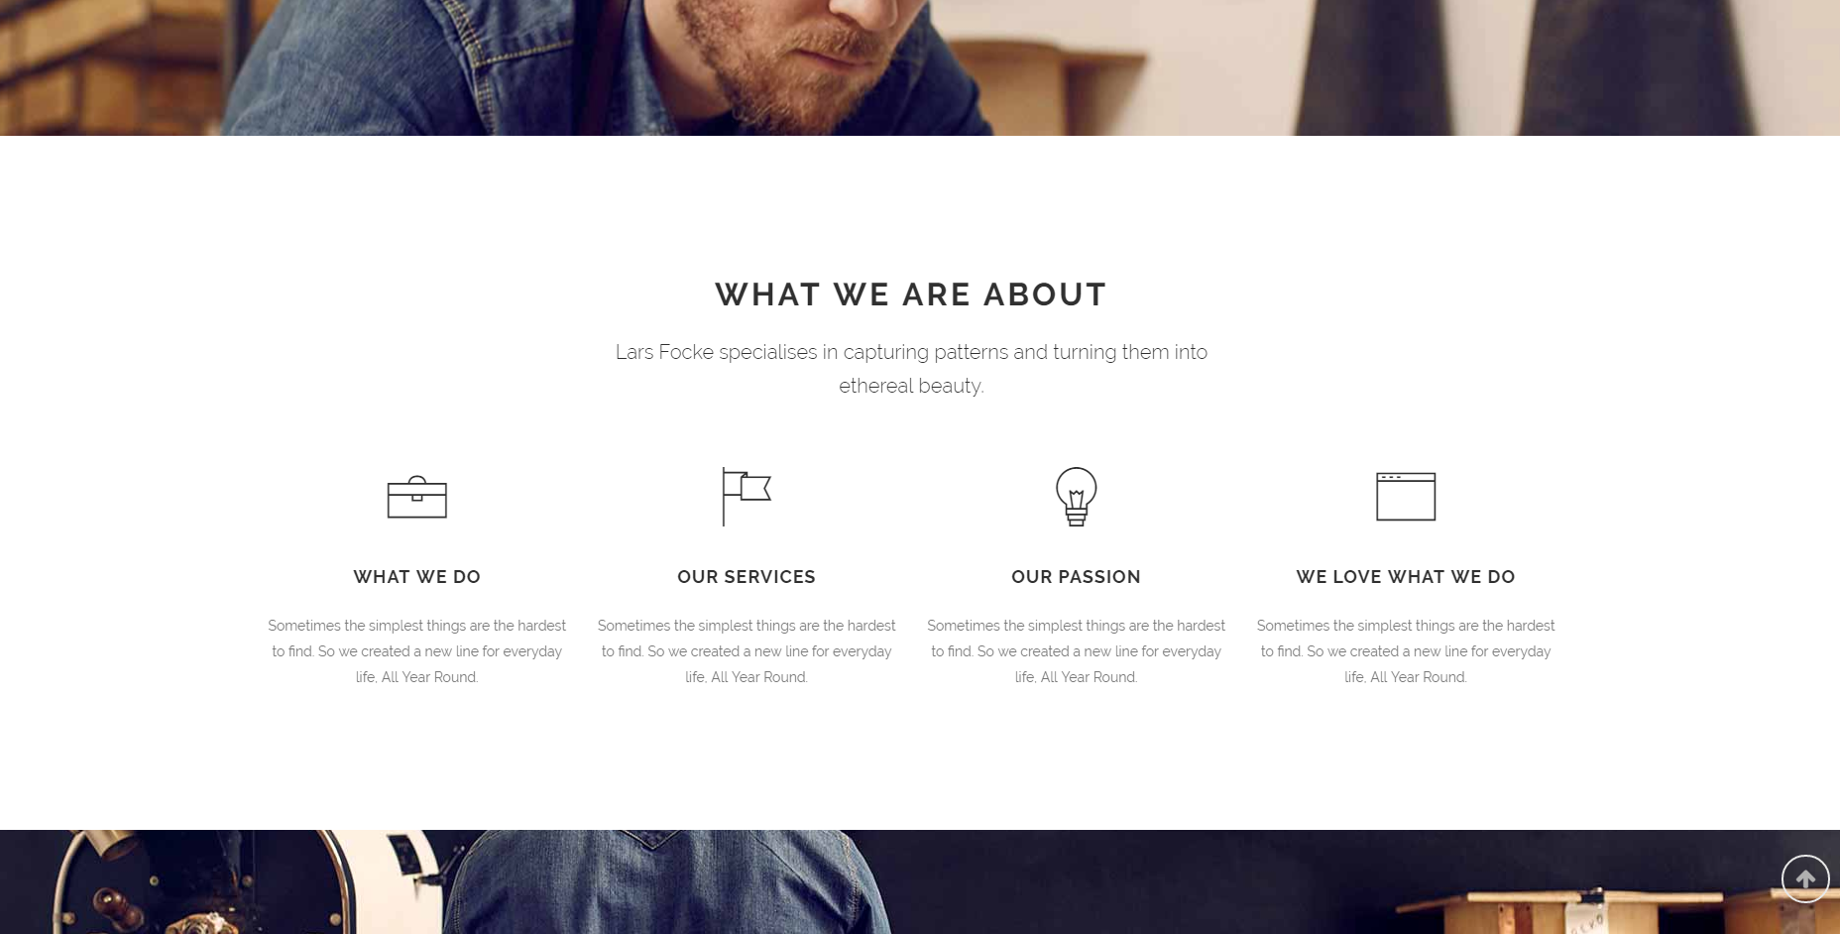
We are committed to doing the right thing for our clients. We employ a straightforward, no-nonsense approach, and deliver smart, creative and experienced solutions
Who We Are
Approach
Well Rounded
Focus
Results
Our clients objectives guide our approach. We look for the best path to accomplish your goals.
Looking at our clients situation from a variety of lenses, enables broad perspective and creative solutions.
We focus on the impact to what is most important to you, not just the business.
We judge ourselves and our success on the actionable results we achieve for our clients.
Notes:
Below top home page

Slide 6
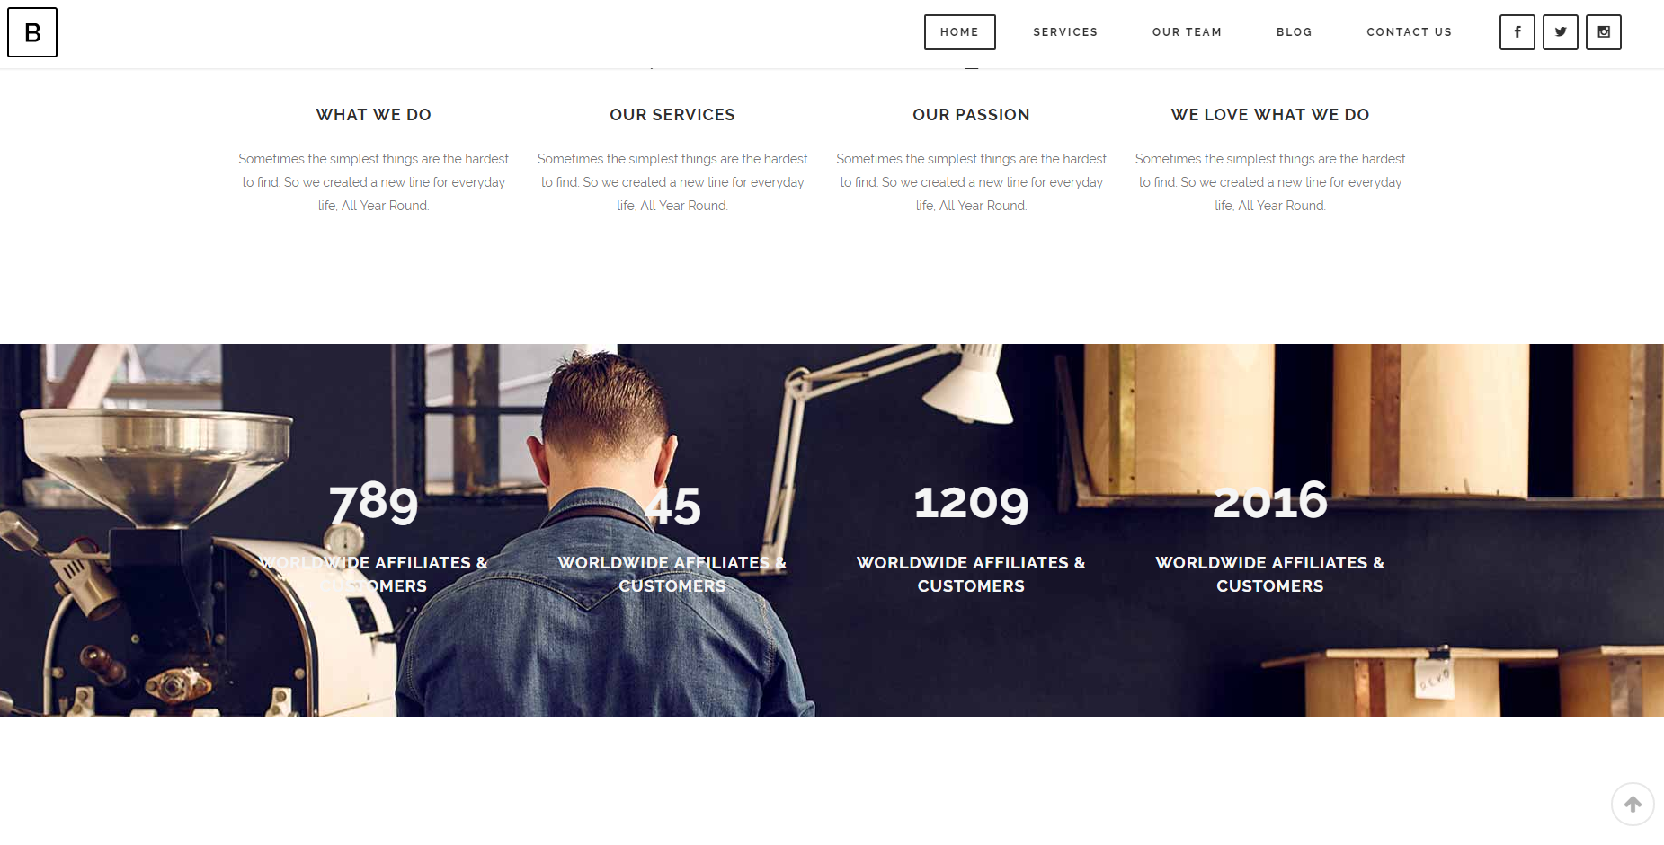
Your objectives guide our approach. We will find the best path to accomplish your goals.
956
Businesses Transitioned
46
States Worked In
2538
Shareholders Assisted
30
Years in Business
Notes:
Below “What We Are About” on home page

Slide 7
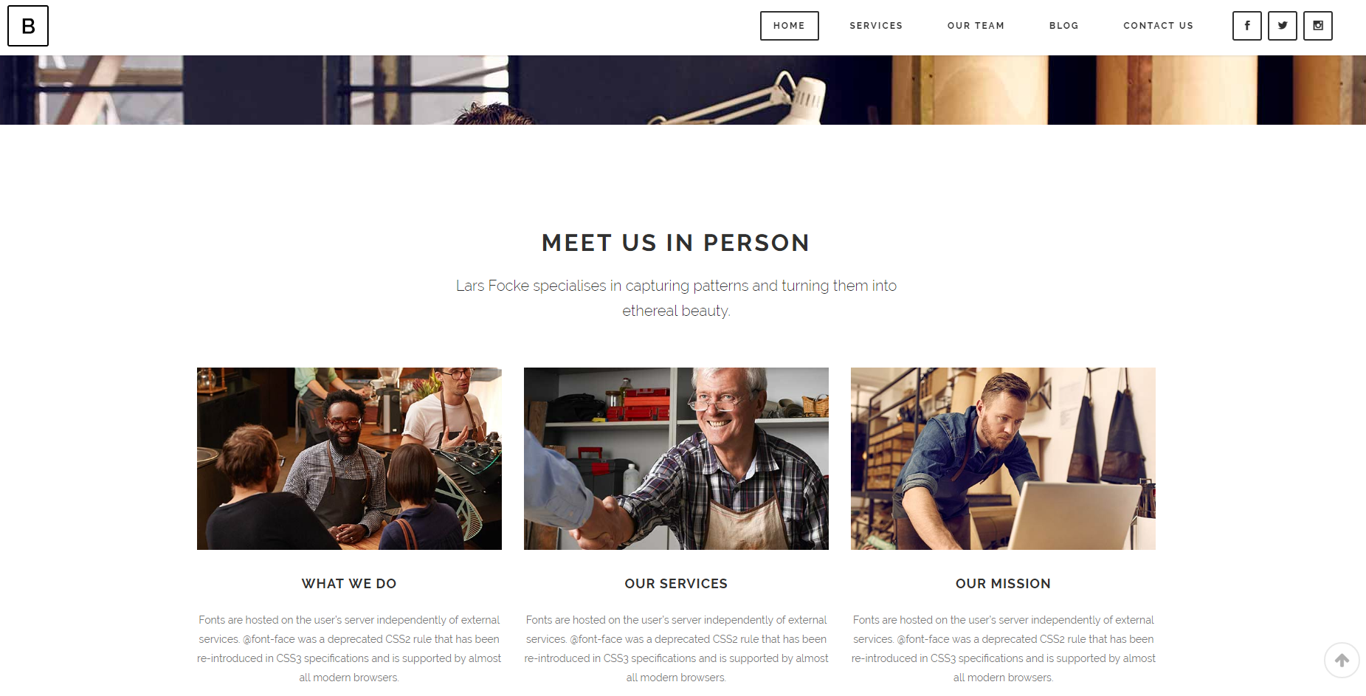




Slide 8
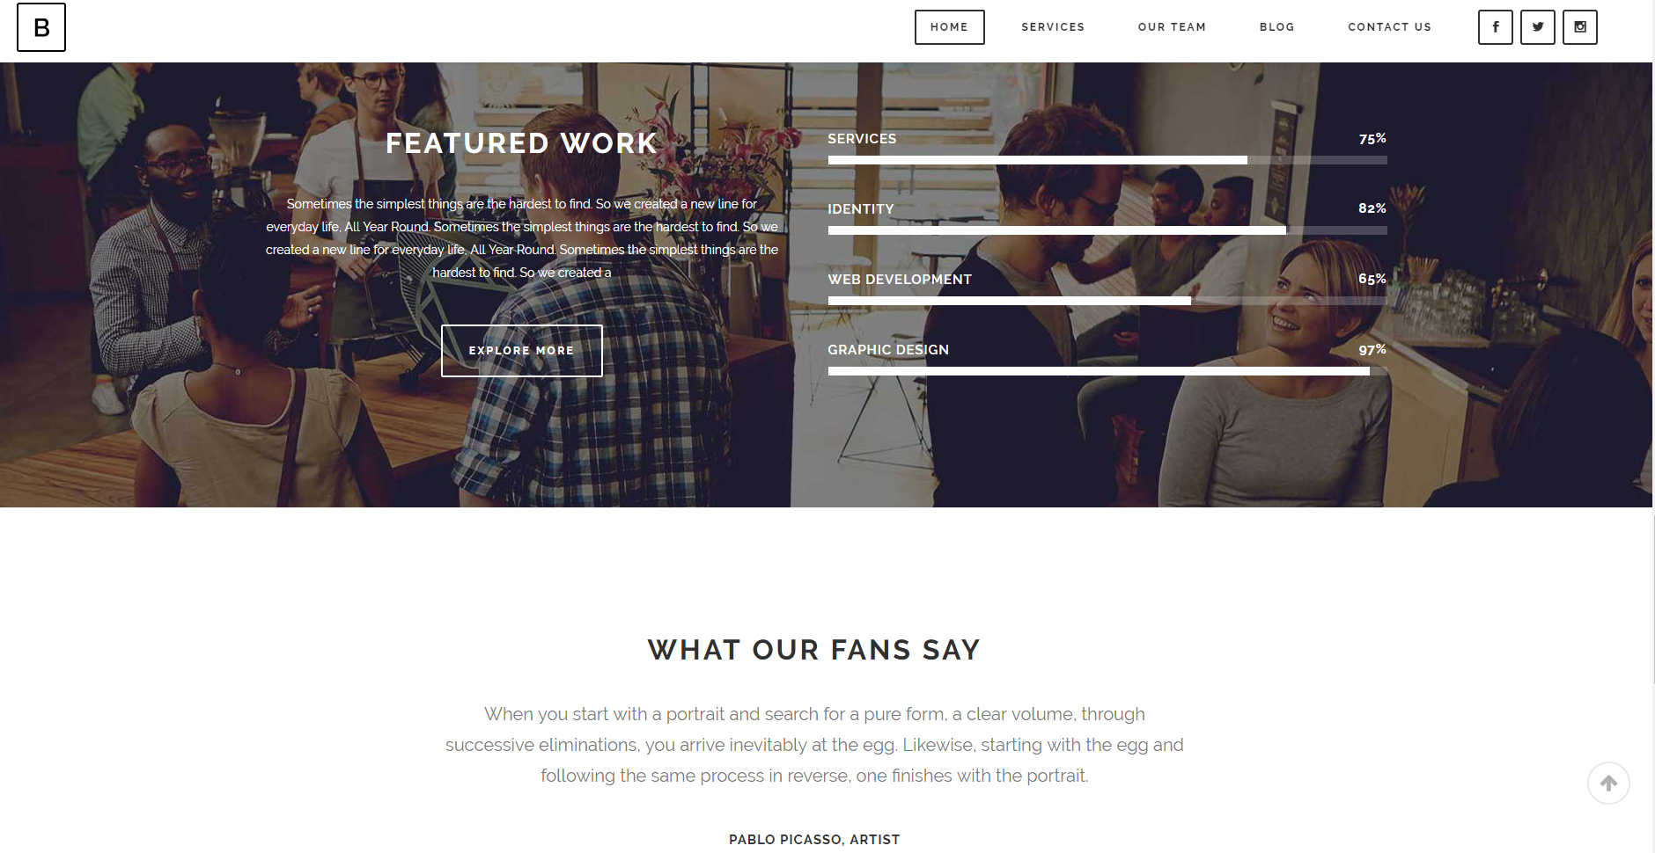
Internal Transitions 30%
External Sales 32%
Family Transitions 25%
Other Engagements 15%

Slide 9
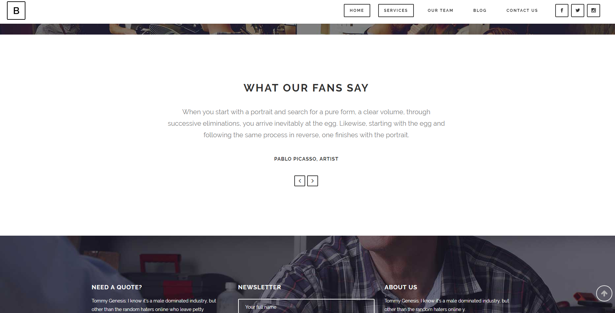
What Our Clients Say
RG Client Testimonial

Slide 10
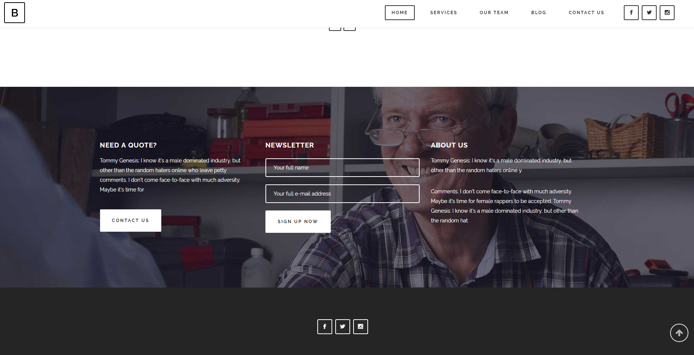

Connect With Us
Notes:
Bottom of Home Page

Slide 11
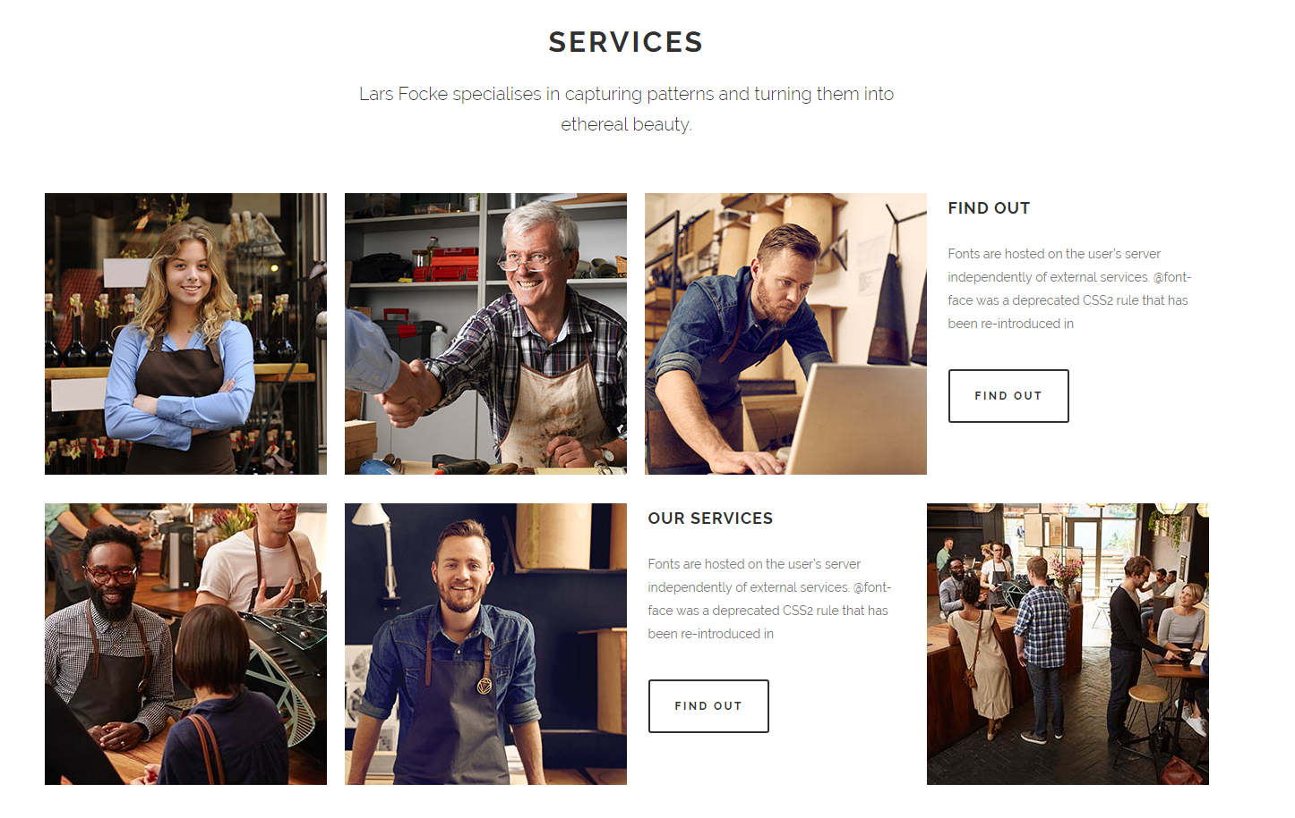
Notes:
“Services” Tab: We’ll have 4-6 key service items; brief description then click through button for additional content

